Slide 1
Creative Writing Through Literature at KS4

Slide 2
Major Literature texts studied in GCSE:
An Inspector Calls
Dr Jekyll and Mr Hyde
Macbeth
Conflict and War Poetry

Slide 3
Focus on Characterisation

Slide 4
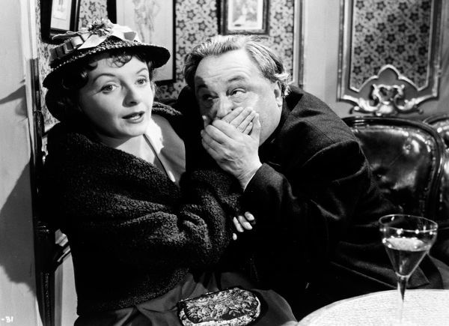
An Inspector Calls
What is happening in this scene with Eva Smith?

Slide 5
An Inspector Calls
Focus on the character of Eva Smith. Write a short creative writing piece about ‘The Meeting At The Palace Bar’ when Gerald meets Eva Smith for the first time.
-How is she dressed?
-What is she doing?
-How does she react when Gerald approaches and ‘rescues’ her?
-What does she say and do when she and Gerald go to the county hotel to talk and get something to eat?

Slide 6
Text Extracts:
Gerald: she looked young and fresh and charming and altogether out of place down here. And obviously she wasn't enjoying herself. Old Joe Meggarty, half-drunk and goggle-eyed, had wedged her into a corner with that obscene fat carcass of his—
Gerald: the girl saw me looking at her and then gave me a glance that was nothing less than a cry for help. So I went across and told Joe Meggarty some nonsense – that the manager had a message for him or something like that – got him out of the way – and then told the girl that if she didn't want any more of that sort of thing, she'd better let me take her out of there. She agreed at once.
Inspector: Where did you go?
Gerald: We went along to the county hotel, which I knew would be quiet at that time of night, and we had a drink or two and talked.
Inspector: Did she drink much at the time?
Gerald: No. she only had a port and lemonade – or some such concoction. All she wanted was to talk – a little friendliness – and I gathered that Joe Meggarty's advances had left her rather shaken – as well they might-- Inspector: she talked about herself? Gerald: yes. I asked her questions about herself. She told me her name was Daisy Renton, that she'd lost both parents, that she came originally from somewhere outside Brumley. She also told me she'd had a job in one of the works here and had had to leave after a strike. She said something about the shop too, but wouldn't say which it was, and she was deliberately vague about what happened. I couldn't get any exact details from her about herself – just because she felt I was interested and friendly – but at the same time she wanted to be Daisy Renton – and not Eva Smith. In fact, I heard that name for the first time tonight. What she did let slip – though she didn't mean to – was that she was desperately hard up and at that moment was actually hungry. I made the people at the county find some food for her.

Slide 7
Sample Answer:
What are the strengths and weaknesses of the following answer?
Is this a strong example of ‘characterisation’?
Eva squirmed in panic and disgust as the fleshly, goggle-eyed man with the breath smelling of whiskey came increasingly near her. His breath stank, no reeked and she felt a wave of nausea wash over her. She clutched desperately at her empty and battered handbag, considering for a wild moment whether is would be wise to batter him over the head in order to make a hasty escape. No, she could not create a scene. She looked up and there was a tall figure holding out a hand. Amidst the hazy smoke and dim, lurid lighting of the Palace bar, that was all she could perceive at that moment as everything swum before her eyes. She clasped the hand and it was warm, strong and comforting. It pulled her up to her feet and she felt a similarly powerful arm around her waist, holding her up and guiding her towards the invigorating fresh evening air.

Slide 8
Poetry: My Last Duchess
Write a short creative writing piece about the Duchess as she is walking through her palace and smiling and greeting her servants while she is preparing for her portrait.
-What does she look like?
-How does she move and interact with the people around her?
-How do people react to the Duchess?
-What is she thinking?
-What is the Duke thinking?

Slide 9
Sir, ’twas not
Her husband’s presence only, called that spot
Of joy into the Duchess’ cheek; perhaps
Fra Pandolf chanced to say, “Her mantle laps
Over my lady’s wrist too much,” or “Paint
Must never hope to reproduce the faint
Half-flush that dies along her throat.” Such stuff
Was courtesy, she thought, and cause enough
For calling up that spot of joy. She had
A heart—how shall I say?— too soon made glad,
Too easily impressed; she liked whate’er
She looked on, and her looks went everywhere.
Sir, ’twas all one! My favour at her breast,
The dropping of the daylight in the West,
The bough of cherries some officious fool
Broke in the orchard for her, the white mule
She rode with round the terrace—all and each
Would draw from her alike the approving speech,
Or blush, at least. She thanked men—good! but thanked
Somehow—I know not how—as if she ranked
My gift of a nine-hundred-years-old name
With anybody’s gift.
Text Extract
‘My Last Duchess’

Slide 10
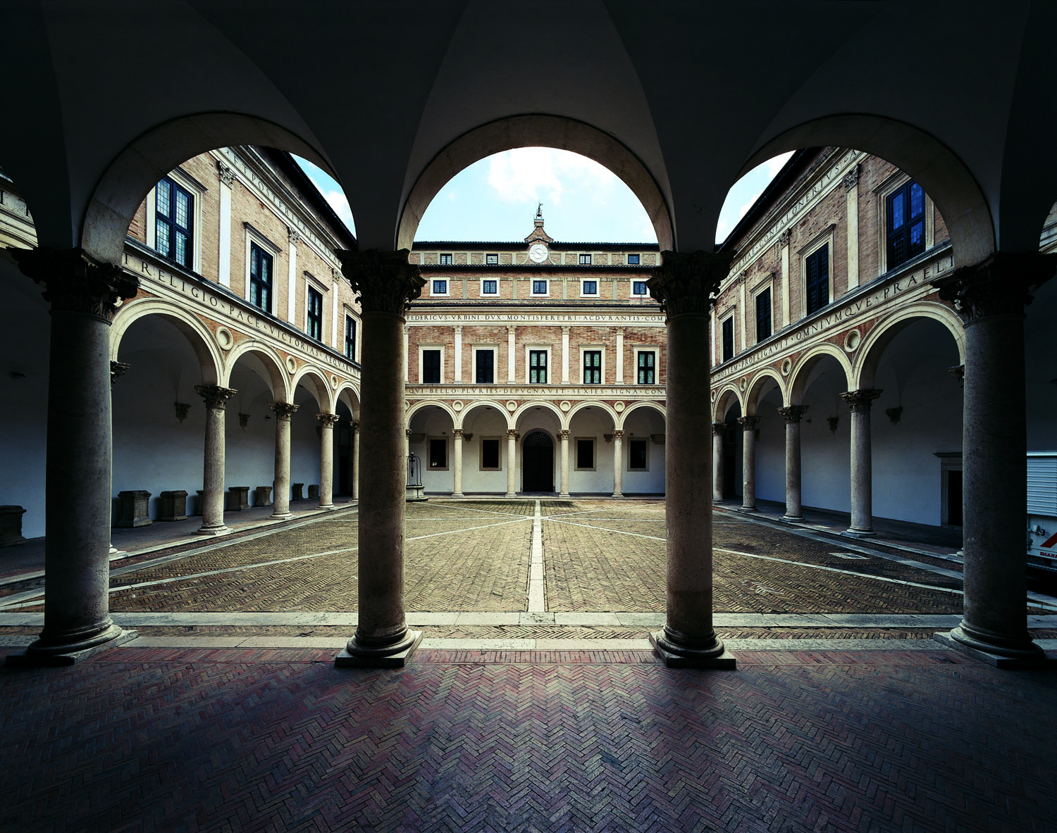
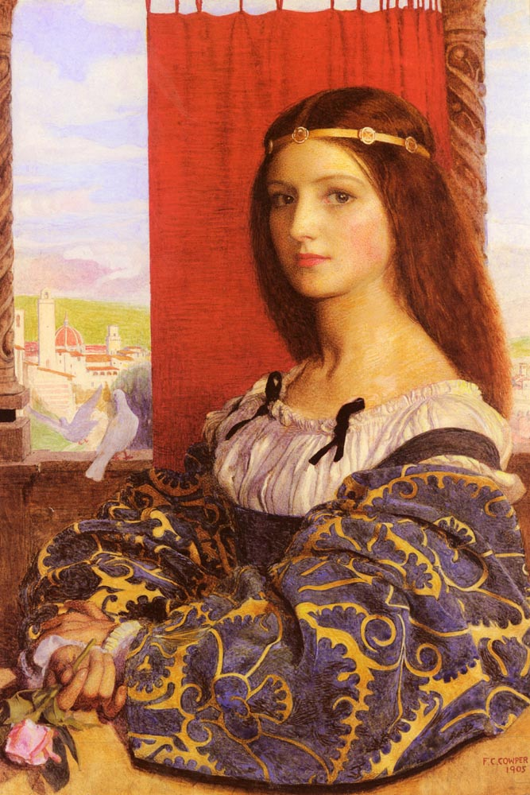
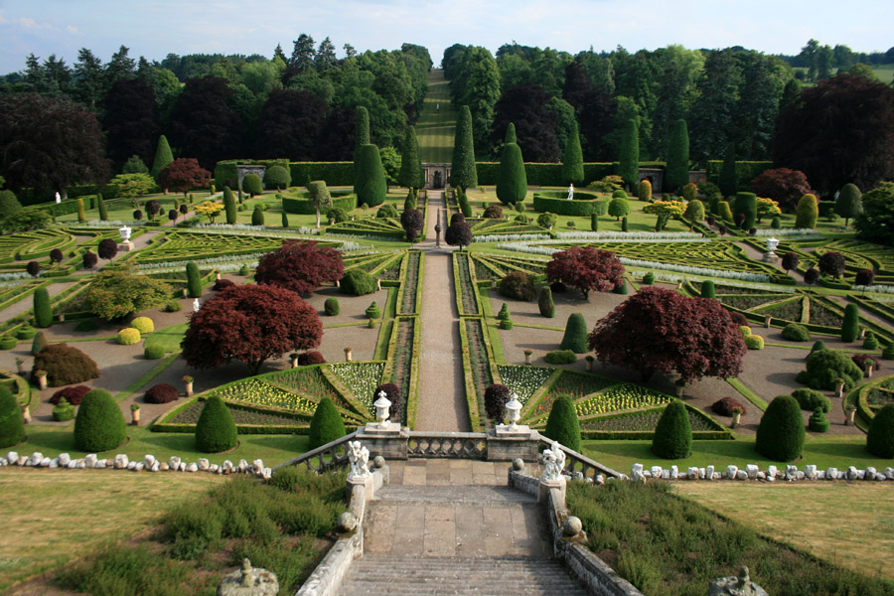

Slide 11
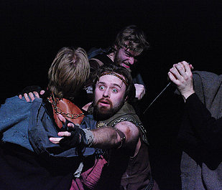
Macbeth
How is Banquo feeling? What is he thinking? What is he trying to do?

Slide 12
Macbeth – Act 3 Scene 3
Write a short creative writing piece about Banquo as he is being attacked by Macbeth’s murderers.
-How does he deal with the murderers?
-How does he protect his son, Fleance?
-What is he thinking and feeling?
-What does he remember in his dying moments?

Slide 13
Text Extract - Macbeth – Act 3, Scene 3
[Enter BANQUO, and FLEANCE with a torch]
Third Murderer. 'Tis he.1255
First Murderer. Stand to't.
Banquo. It will be rain to-night.
First Murderer. Let it come down.
[They set upon BANQUO]
Banquo. O, treachery! Fly, good Fleance, fly, fly, fly!1260 Thou mayst revenge. O slave!
[Dies. FLEANCE escapes]

Slide 14
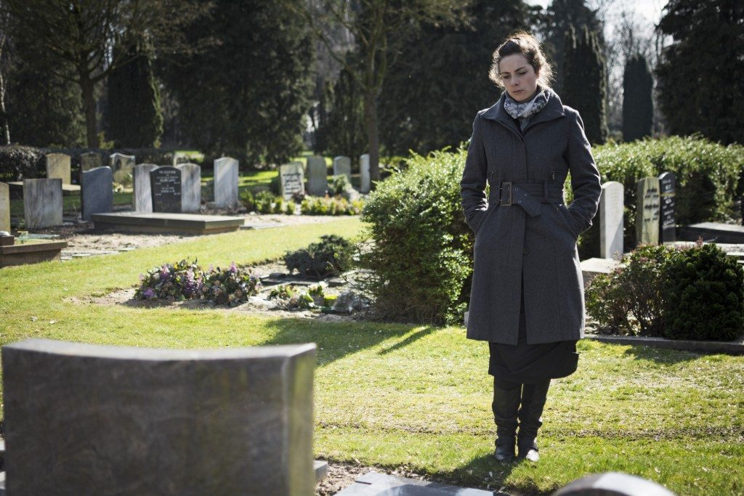
Poetry: ‘Poppies’
How is the mother feeling? What is she thinking?
What does she want to do? What does she remember?

Slide 15
Poetry – ‘Poppies’
Write a short creative writing piece about the mother in ‘Poppies’ as observed by a passer-by when she is wandering in the churchyard and by the World War 1 Memorial

Slide 16
Text Extract – ‘Poppies’
On reaching the top of the hill I traced
The inscriptions on the war memorial,
Leaned against it like a wishbone.
The dove pulled freely against the sky,
An ornamental stitch. I listened, hoping to hear
Your playground voice catching on the wind.

Slide 17
Focus on Literary Techniques

Slide 18
Match the literary technique with the example.
Simile The sun scorched through the day.
Metaphor The clouds crowded together suspiciously overhead as the sky darkened.
Personification A heart-breaking aroma of death filled the air as he surveyed the devastation and destruction that had befallen them all.
Pathetic Fallacy The circus was a magnet for the children.
Hyperbole There was a deafening silence
Oxymoron The autumn leaves and twigs cracked and crunched underfoot.
Emotive Language The sun smiled at the hills, ready to begin a new day.
Onomatopoeia The trees stood as tall as towers

Slide 19
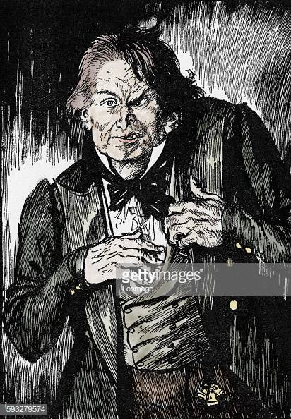
Dr Jekyll and Mr Hyde
What is happening?
What is Jekyll thinking?
What is Hyde thinking?

Slide 20
Dr Jekyll and Mr Hyde
Write a short creative writing piece about the moment of transformation from Jekyll into Hyde
-Focus on Jekyll’s thoughts and feelings as he is about to take the potion
-Describe the sensations and thoughts and he is going through the transformation
-Focus on Hyde’s thoughts and feelings after the transformation is complete
Use literary techniques! Simile, Metaphor, Personification, Pathetic Fallacy, Hyperbole, Oxymoron, Emotive Language, Onomatopoeia

Slide 21
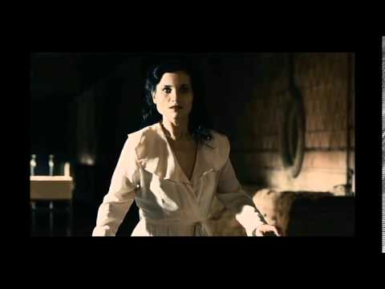
Macbeth
What is Lady Macbeth thinking about? What can she see and hear?

Slide 22
Macbeth
Write a short creative writing piece about Lady Macbeth when she is evoking the spirits in Act 1 Scene 5.
-What can she see and hear?
-What is she thinking of?
-What does she remember from the past?
-What vision of the future does she imagine?
Use literary techniques! Simile, Metaphor, Personification, Pathetic Fallacy, Hyperbole, Oxymoron, Emotive Language, Onomatopoeia

Slide 23
Macbeth, Act 1 Scene 5
Come, you spirits That tend on mortal thoughts, unsex me here, And fill me from the crown to the toe top-full Of direst cruelty! make thick my blood; Stop up the access and passage to remorse, That no compunctious visitings of nature Shake my fell purpose, nor keep peace between The effect and it! Come to my woman's breasts, And take my milk for gall, you murdering ministers, Wherever in your sightless substances You wait on nature's mischief! Come, thick night, And pall thee in the dunnest smoke of hell, That my keen knife see not the wound it makes, Nor heaven peep through the blanket of the dark, To cry 'Hold, hold!'

Slide 24
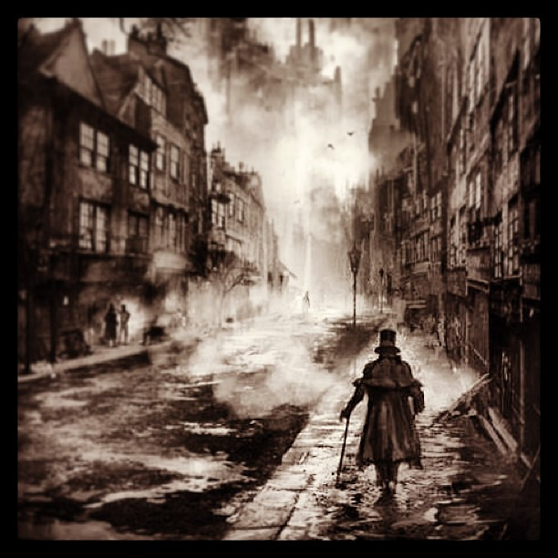
Dr Jekyll and Mr Hyde
Where is Mr Enfield coming from? What has he been doing?
What is the atmosphere in the street?

Slide 25
Dr Jekyll and Mr Hyde
Write a short creative writing piece about Richard Enfield returning home early in the morning and witnessing Hyde trampling the little girl
Use literary techniques! Simile, Metaphor, Personification, Pathetic Fallacy, Hyperbole, Oxymoron, Emotive Language, Onomatopoeia

Slide 26
Focus on
Narrative Openings

Slide 27
Narrative Hooks can be:
funny – appeal to the reader’s sense of humour
atmospheric – evoke a particular mood through description of a place or emotion
speech – capture the immediate action and scene
direct address – talk directly to the reader
question – encourage the reader to find an answer

Slide 28
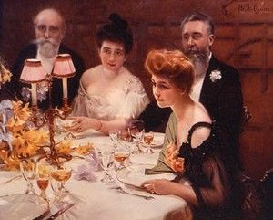
An Inspector Calls
What does this image make you think of?

Slide 29
Write an opening for ‘An Inspector Calls’ from Edna’s perspective using:
-question and addressing the reader
-atmospheric
-speech
-humour

Slide 30
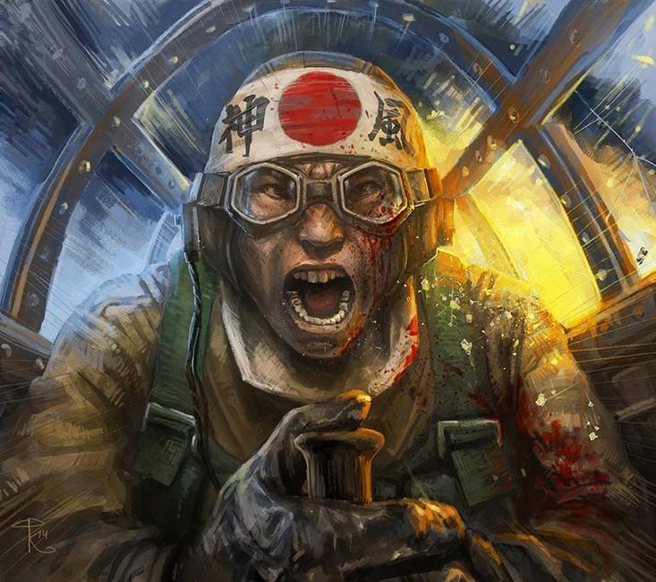
Poetry: ‘Kamikaze’
What is happening in this picture? How is the kamikaze soldier feeling?
What is he thinking of?

Slide 31
Poetry: ‘Kamikaze’
Write the opening to a story based on ‘Kamikaze’ using one or more of the following narrative hooks:
-question and addressing the reader
-atmospheric
-speech
-humour

Slide 32
and beneath them, arcing in swathes like a huge flag waved first one way then the other in a figure of eight, the dark shoals of fishes flashing silver as their bellies swivelled towards the sun
and remembered how he and his brothers waiting on the shore built cairns of pearl-grey pebbles to see whose withstood longest the turbulent inrush of breakers bringing their father’s boat safe
– yes, grandfather’s boat – safe to the shore,
Text Extract:
Her father embarked at sunrise with a flask of water, a samurai sword in the cockpit, a shaven head full of powerful incantations and enough fuel for a one-way journey into history
but half way there, she thought, recounting it later to her children, he must have looked far down at the little fishing boats strung out like bunting on a green-blue translucent sea

Slide 33
Focus on
Sentence Variation

Slide 34
Varying sentence structures
Technique | Example
Open with an adverb (describes the verb) | Hysterically, the girl began to laugh…
Open with a verb (doing word/action) | Sauntering towards the exam hall, the student couldn’t control his dread…
Open with a simile | Like a dangerous assassin, the cat waited patiently to pounce…
Open with 3 adjectives | Silvery, shimmering and bright, the sea stretched out endlessly into the horizon…
Open with ‘Although’ or ‘Despite’ | Although the fire had been blazing relentlessly for three months, it was showing no signs of stopping…
Open with a noun phrase | Tables and chairs littered the empty hallway…
Open with a prepositional phrase | Beneath the bridge, the children giggled hysterically at the fact they had managed to shake off their dad…

Slide 35
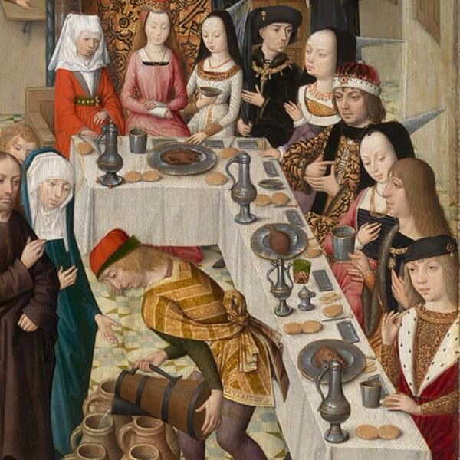
Macbeth
What is happening?
How does everyone feel?
What are they thinking?

Slide 36
Macbeth
Write a description of the banquet scene in Macbeth
in Act 3 Scene 4
Start sentences with an adverb / a verb / a simile / 3 adjectives /
‘Despite’ / ‘Although’ / noun phrase / prepositional phrase

Slide 37
Act 3 Scene 4
[A banquet prepared. Enter MACBETH, LADY MACBETH,] [p]ROSS, LENNOX, Lords, and Attendants]
Macbeth. You know your own degrees; sit down: at first And last the hearty welcome.
Lords. Thanks to your majesty.
Macbeth. Ourself will mingle with society,1275 And play the humble host. Our hostess keeps her state, but in best time We will require her welcome.
Lady Macbeth. Pronounce it for me, sir, to all our friends; For my heart speaks they are welcome.1280
[First Murderer appears at the door]
Macbeth. See, they encounter thee with their hearts' thanks. Both sides are even: here I'll sit i' the midst: Be large in mirth; anon we'll drink a measure The table round.

Slide 38
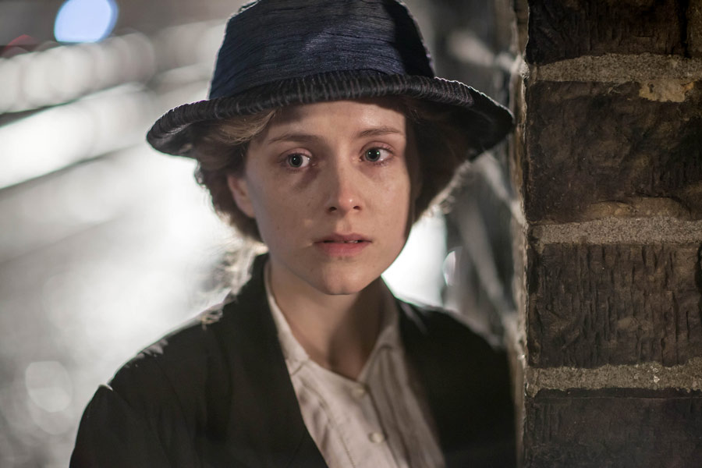
An Inspector Calls
Where is Eva Smith? What is she doing or about to do?
How is feeling? What is she thinking of?

Slide 39
An Inspector Calls
Write about the last moments of Eva Smith in ‘An Inspector Calls’
Start sentences with an adverb / a verb / a simile / 3 adjectives /
‘Despite’ / ‘Although’ / noun phrase / prepositional phrase

Slide 40
Text Extract – An Inspector Calls – Act 1
Inspector: I’d like some information, if you don't mind, Mr Birling. Two hours ago a young woman died on the infirmary. She'd been taken there this afternoon because she'd swallowed a lot of strong disinfectant. Burnt her inside out, of course.
Eric: (involuntarily) My god!
Inspector: Yes, she was in great agony. They did everything they could for her at the infirmary, but she died. Suicide, of course.

Slide 41
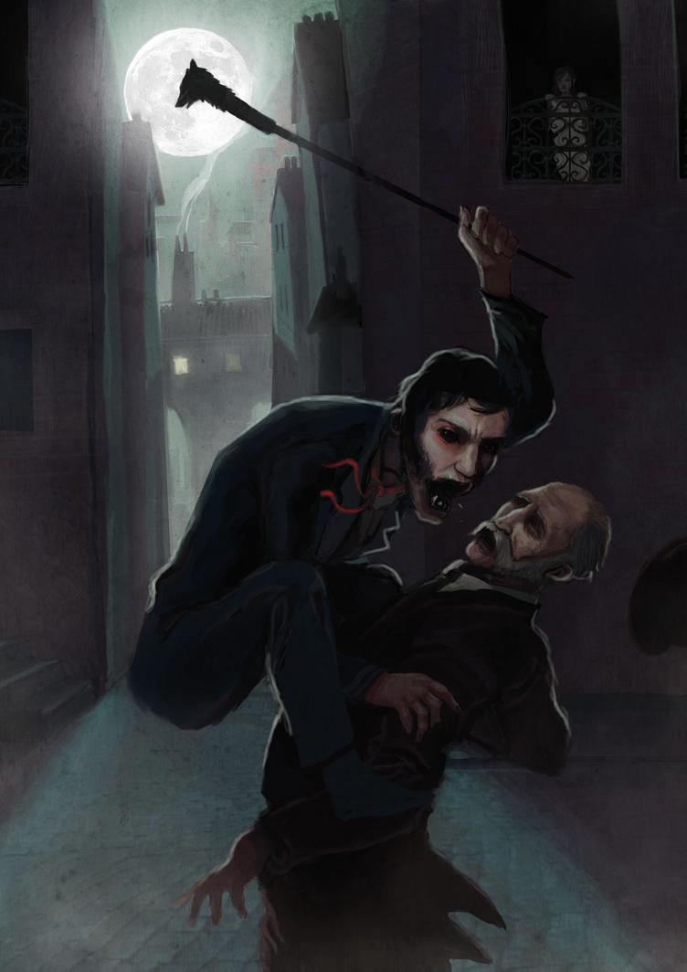
Dr Jekyll and Mr Hyde
How does Sir Danvers Carew feel?
What is he trying to do?
What is he thinking of?

Slide 42
Dr Jekyll and Mr Hyde
Write about the last living moments of Sir Danvers Carew
from his perspective.
Start sentences with an adverb / a verb / a simile / 3 adjectives /
‘Despite’ / ‘Although’ / noun phrase / prepositional phrase

Slide 43
Text Extract – Dr Jekyll and Mr Hyde – ‘The Carew Murder Case’
And as she so sat she became aware of an aged beautiful gentleman with white hair, drawing near along the lane; and advancing to meet him, another and very small gentleman, to whom at first she paid less attention. When they had come within speech (which was just under the maid's eyes) the older man bowed and accosted the other with a very pretty manner of politeness. It did not seem as if the subject of his address were of great importance; indeed, from his pointing, it some times appeared as if he were only inquiring his way; but the moon shone on his face as he spoke, and the girl was pleased to watch it, it seemed to breathe such an innocent and old-world kindness of disposition, yet with something high too, as of a well-founded self-content. Presently her eye wandered to the other, and she was surprised to recognise in him a certain Mr. Hyde, who had once visited her master and for whom she had conceived a dislike. He had in his hand a heavy cane, with which he was trifling; but he answered never a word, and seemed to listen with an ill-contained impatience. And then all of a sudden he broke out in a great flame of anger, stamping with his foot, brandishing the cane, and carrying on (as the maid described it) like a madman. The old gentleman took a step back, with the air of one very much surprised and a trifle hurt; and at that Mr. Hyde broke out of all bounds and clubbed him to the earth. And next moment, with ape-like fury, he was trampling his victim under foot and hailing down a storm of blows, under which the bones were audibly shattered and the body jumped upon the roadway. At the horror of these sights and sounds, the maid fainted.

Slide 44
Focus on
Structure

Slide 45
When planning and structuring a piece of work, the first thing you need to think about is whether you are going to write a LINEAR or a NON LINEAR piece
LINEAR – This is where the events in a narrative are SEQUENCED and ORDERED in a logical way, often in chronological (time) order.
NON-LINEAR – This is where the events in a narrative are ‘jumbled up’ including structural features such as flash backs, flash forwards, locational shifts and shifts in narrative perspective (who is telling the story).

Slide 46
Non-Linear Narratives
Stream of consciousness – this is where the narrator in the story literally says whatever it is that comes into their heads. This means that often the story can ‘jump around’ between different settings, characters and time periods.
Flashback stories – A flashback story has 2 timelines. The ‘present day’ and various moments in the past. Often it is the past events that give the reader more understanding about the present situation. E.g. the reader might learn through a flashback that the main character was a prisoner, which might help explain why the main character has a number tattooed on his arm.

Slide 47
Non-Linear Narratives
Parallel Narratives – This is where you are essentially telling the story of two people, and switching between the two. Often in parallel narratives the two characters will somehow be linked, with each person’s life revealing information and details about the other. E.g. telling the parallel narrative of twins who were separated at birth and are eventually reunited.
Circular Narratives – A circular narrative is a story that ends exactly where it began. In this way, the whole story is a sort of flashback working its way to the present day moment at the end.

Slide 48
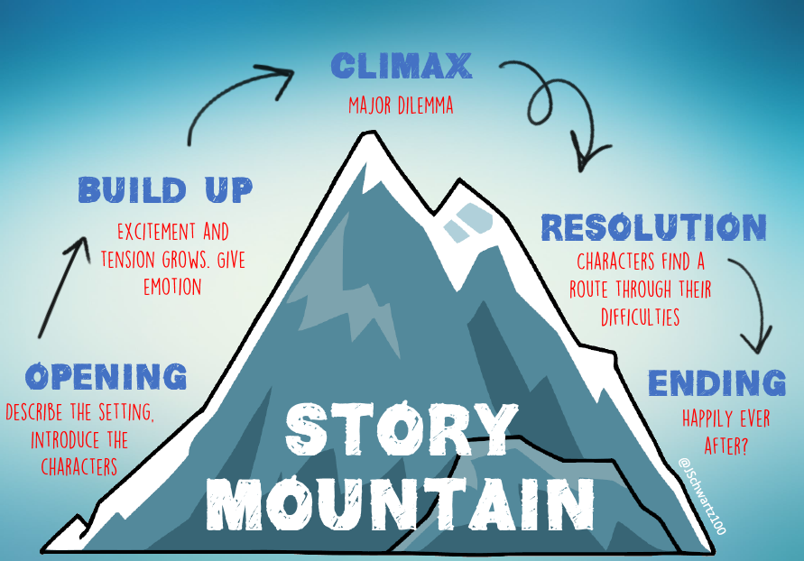
Planning a Linear Narrative:
Inciting Incident
Exposition

Slide 49
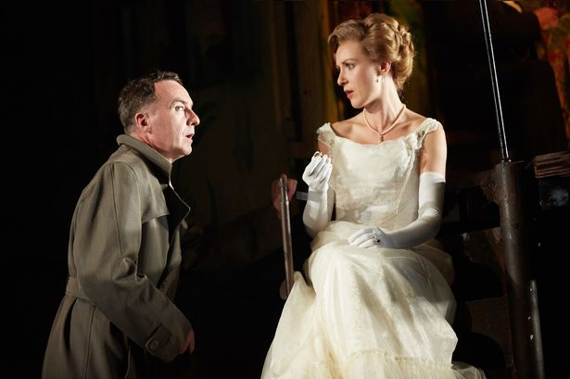
An Inspector Calls
Write a short story on
how Sheila Birling
changed her life around
after the Inspector’s visit.
Linear - Opening, Build Up, Climax, Resolution, Ending
Non Linear – Stream of Consciousness, Parallel, Narratives, Flashback, Circular narrative

Slide 50
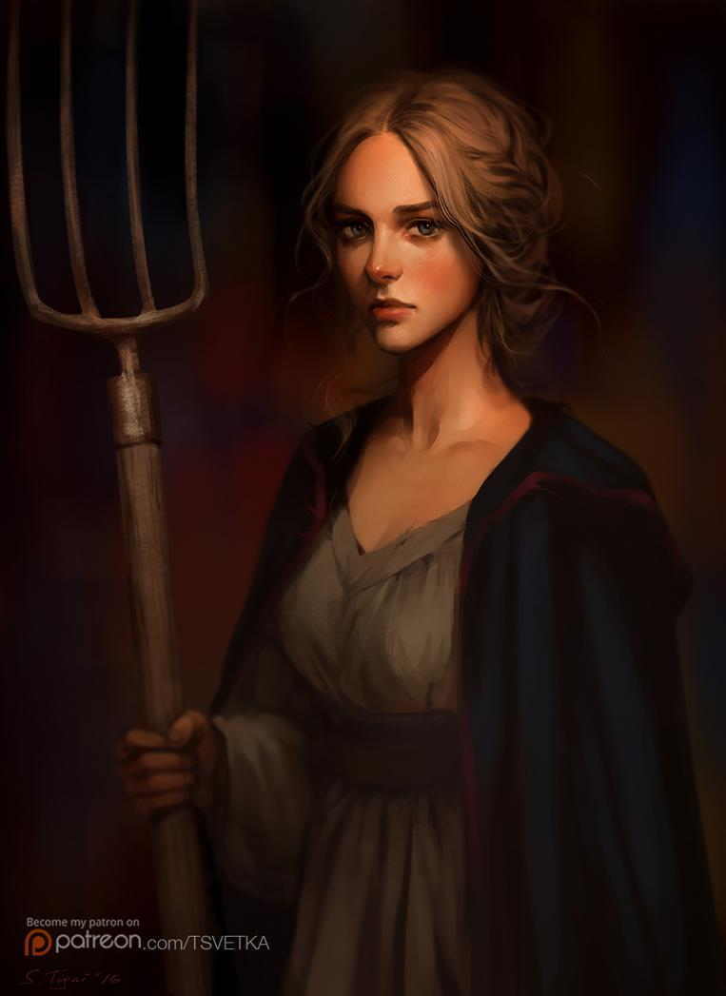
Macbeth
Imagine the backstory to ‘Macbeth’,
explaining how the young and
poor girl who was to become Lady
Macbeth flirted, manipulated and
entrapped Macbeth into marrying
her so she could be a ‘Lady’.
Linear - Opening, Build Up, Climax,
Resolution, Ending
Non Linear – Stream of Consciousness, Parallel,
Narratives, Flashback, Circular narrative

Slide 51
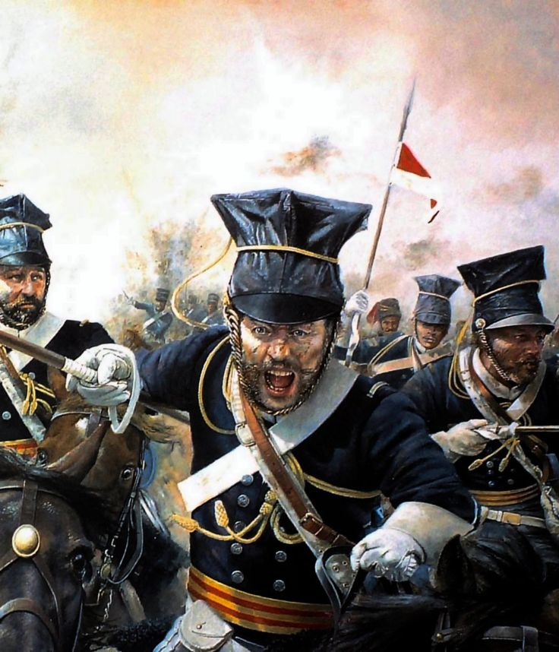
Poetry ‘Charge of the Light Brigade’
Write the story of a soldier who was part of the ‘600’ who attacked the Russians based on the poem ‘The Charge
of the Light Brigade’
Linear - Opening, Build Up, Climax, Resolution, Ending
Non Linear – Stream of Consciousness, Parallel, Narratives, Flashback, Circular narrative

Slide 52
Focus on
The Senses

Slide 53
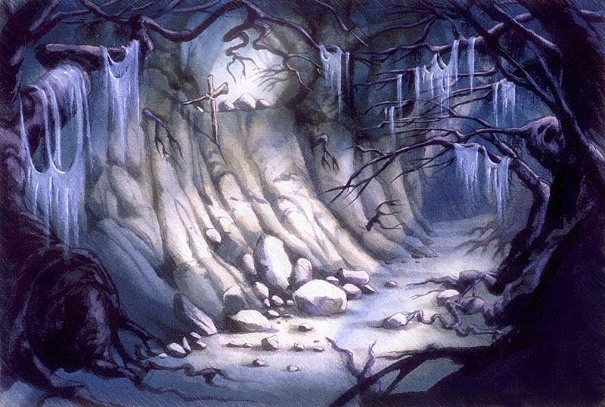
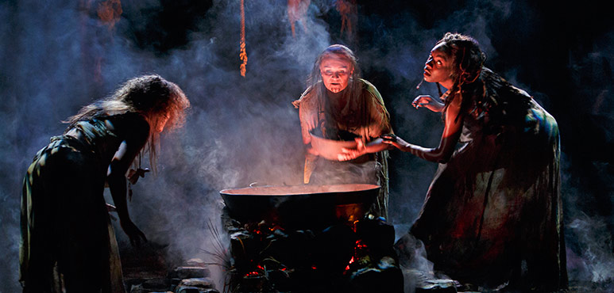
Write a description of the cave when the witches
are preparing a potion for Macbeth as he comes
to speak to them a second time in Act 4 Scene 1
Refer to the 5 senses:
sight / smell / touch / hearing / taste

Slide 54
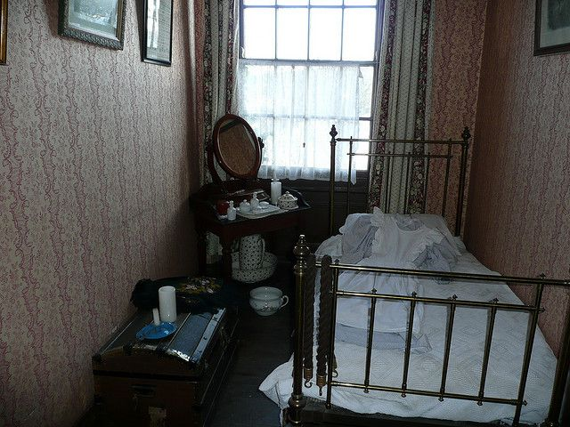
An Inspector Calls
Write a description of Eva Smith’s ‘dingy back-room’.

Slide 55
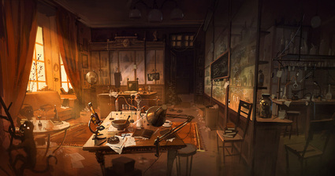
Write a description of the laboratory in ‘Dr Jekyll and Mr Hyde’.
Refer to the 5 senses:
sight / smell / touch / hearing / taste

Slide 56
Focus on
Vocabulary

Slide 57
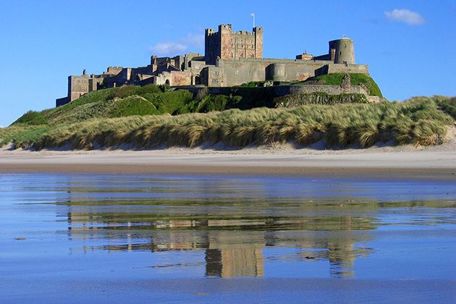
Write a description of Macbeth’s castle and the approach of
‘Birnam Wood’
coming towards ‘Dunsinane’ in
Act 5 Scene 4
Sample Paragraph:
Fourteen thick, round, imposing towers were scattered in a seemingly random pattern, but had been built for an ideal defence and were connected by mammoth walls made of bronzed stone. Tall, wide windows were scattered thinly across the walls in a seemingly random pattern, along with same-sized holes for archers
and artillery. A immense oak gate with wide wooden doors and strong defences guarded the inhabitants of this island castle and it was the only way in, at least without taking down the 10 foot-thick castle walls. A handful of dancing waterfalls flowed into various small rivers and provided the precious farm fields outside the castle with needed water.

Slide 58
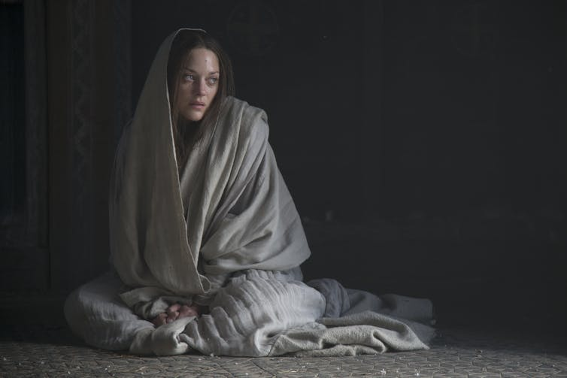
Write about Lady Macbeth’s suicide based on Act 5 Scene 5
Mental
Self-destruction
Hara-kiri
Depressed
Disorder
Intentionally
Failure
Sadness
Anxiety
Guilt
Desperate
Self-slaughter
Lethal
Distress
Injury
Sin
Hellish
Suffering
hallucinations
Demons
Tormented
Distraught
Anguish
Schizophrenia
Neurosis
Failure
Meaninglessness
Isolated
Crisis
Transgression
Regicide
Fatalistic
Grief
Redemption
Abandoned
Insignificant
Marginalised
Childless
Use the vocabulary bank to help you with your writing!

Slide 59
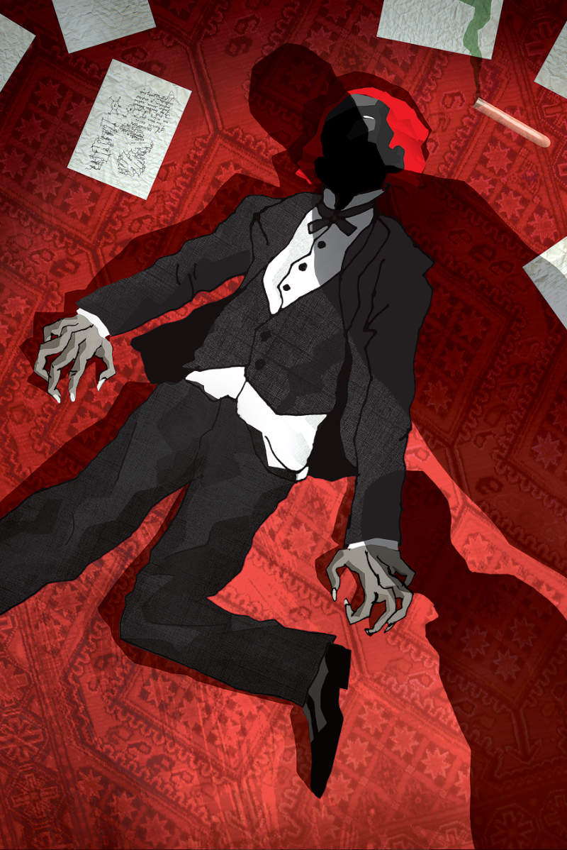
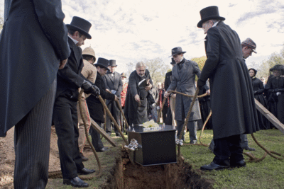
Write about the last moments of Hyde from his own perspective
or the perspective of Utterson.
Quotes about Hyde when he was alive:
‘shrank back with a hissing intake of breath’ / ‘snarled aloud into a savage laugh’ / ‘like some damned Juggernaut’ / ‘trampled calmly over the child’s body’ / ‘the bones were audibly shattered’ / ‘with ape-like fury, he was trampling his victim’ / ‘I mauled the unresisting body, tasting delight from every blow’
Quotes about Hyde when he was dead:
‘a dismal screech, as of mere animal terror’ / ‘the body of a man sorely contorted and still twitching’ / ‘the cords of his face still moved with a semblance of life’ /

Slide 60
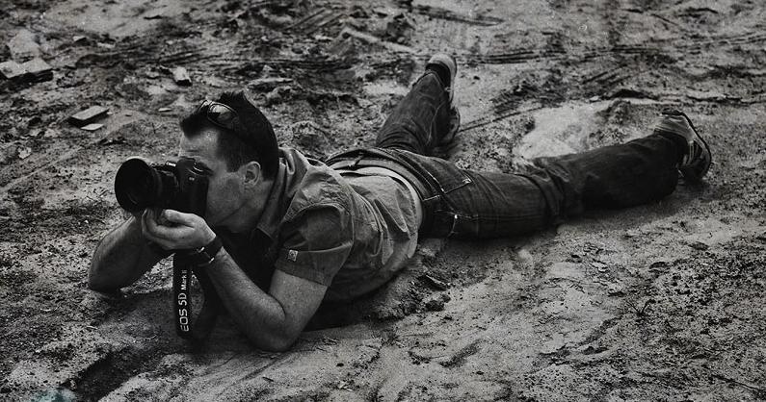
Write about a typical day at work based on the poem ‘War Photographer’
Model Paragraph:
I was one of the first on the scene. The Afghan security forces normally shut down a suicide bombing like this pretty quickly. I was able to get to the epicentre of the explosion. It was carnage, there were bodies, flames were coming out of the buildings. I remember feeling very scared because there was still popping and hissing and small explosions, and the building was collapsing. It was still very fresh and there was a risk of another bomb. It was one of those situations where you have to put fear aside and focus on the job at hand: to watch the situation and document it.
This woman was escorted out of the building and round this devastated street corner. It epitomised the whole mood – this older woman caught in the middle of this ridiculous, tragic event. I wish I could have found out how her life unravelled, but as soon as the scene was locked down, I ran back to the office to file.
As a photographer, you feel helpless. Around you are medics, security personnel, people doing good work. It can be agonisingly painful to think that all you're doing is taking pictures.
Source: https://www.theguardian.com/media/2011/jun/18/war-photographers-special-report

